Slide 1
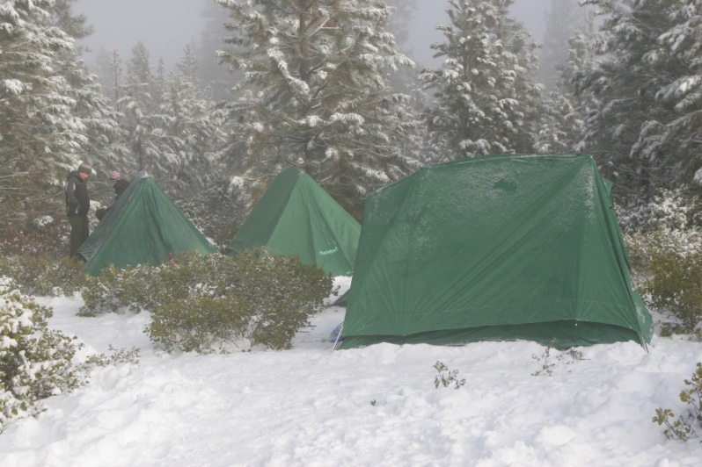
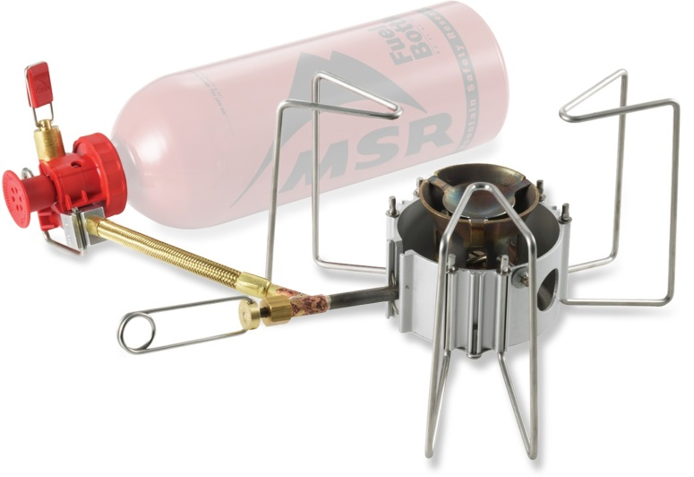
Winter Camping
Josh Isaac, Paul Mokotoff, & Matt Ryan

Slide 2
Today we will learn…
Types of Backpacks
What to pack on a Winter Campout
Packing a Backpack & Strategies
Sizing a Backpack
Nighttime Clothing & Gear
Helpful Hints

Slide 3
Types of Backpacks

Slide 4
Internal Frame
The Internal Frame Backpack has most of the support inside the backpack.
Most of the weight is transferred throughout the waist and back.
This type of backpack is more comfortable for the upper and lower body.
It also has a large area for gear, a small area to pack a sleeping bag and other items, and is much easier to carry on a long backpacking trail.

Slide 5
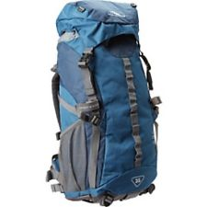

Slide 6
External Frame
The External Frame Backpack has the frame on the outside of the backpack.
It is lighter than an Internal Frame, but is more bulky.
It can carry more weight and has extra zippered pouches.
Items can also be knotted on to the outside of the bag.

Slide 7
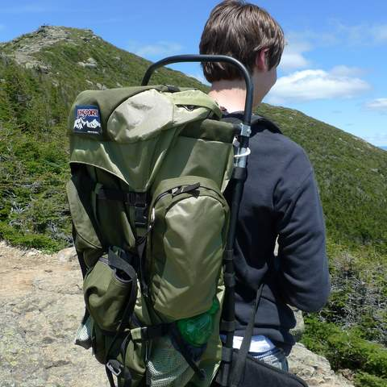

Slide 8
What to Pack on a Winter Campout
Clothing

Slide 9
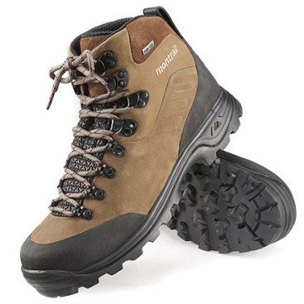
Boots
There are 2 types of Boots: Mid-Calf (High Boots) or Ankle (Low Boots).
No matter which type you purchase, they should be good fitting and waterproof.
Wear them on EVERY campout.
Measuring Test: 2 Finger should fit in between your heel and the back of the boot.
Break your boots in before wearing them on a campout.

Slide 10
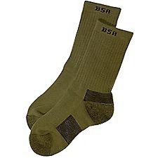
Socks
Scout Socks are the best choice for any campout. Wool and Polyester are also great options if you need extra socks.
COTTON KILLS!!!
Make sure to change your socks when hiking.

Slide 11
Extra Clothing
Always have Extra Clothing in case the clothes you wear gets dirty or wet.
Always Pack: Quantities in [Brackets]
Rain Gear [1 Pair], Many Pairs of Underwear [1 more than the Amount of Nights you are camping], Many Pairs of Socks [3 more than the Amount of Nights you are camping], Sweatshirts [2], Fleece Jacket [1], Winter Coat [1], Many Pairs of Pants [2 more than the Amount of Nights you are camping], Windbreaker [1], Gloves [1 Pair – Must be warm and good fitting], Thermals [1] (Under Armor), Extra Shirts [2 more than the Amount of Nights you are camping], Pajamas [1 Pair], & any other clothing the scout feels he will need for the campout.

Slide 12
What to Pack on a Winter Campout
Gear

Slide 13
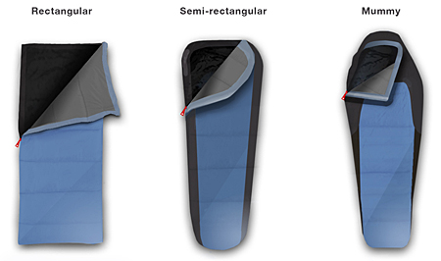
Sleeping Bag
You want a Sleeping Bag that is light and NOT bulky.
There are 2 types of insulation: Down or Synthetic.
Down sleeping bags provide more warmth.
There are 2 styles of a sleeping bag: Mummy or Rectangular.
Mummy bags provide more cover, Rectangular ones provide more space.

Slide 14
Sleeping Bag Ratings
There are 4 types of ratings for a sleeping bag:
Summer: 35 Degrees and Above
3 Season: 10 to 35 Degrees
Cold: -10 to 10 Degrees
Winter: -10 and Below
It is best to purchase a 3 Season or Cold Rated Sleeping Bag…Even for the Summer.

Slide 15
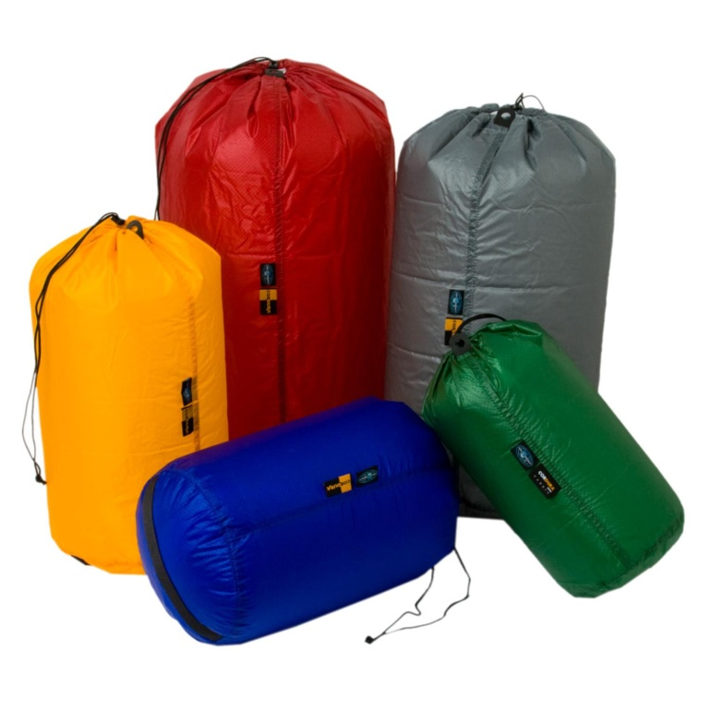
Stuff Sack
A Stuff Sack keeps a Sleeping Bag condensed and unexposed from the weather.
Purchase one that is sized for your sleeping bag, or it will come with the sleeping bag.

Slide 16
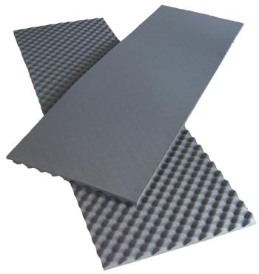
Sleeping Pad
A Sleeping Pad will be a barrier between you and the ground.
A Full-Length Pad should be purchased.

Slide 17
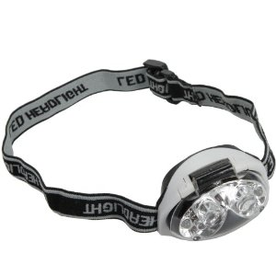
Headlight
A Headlight keeps your hands free to do any task in the woods.
Make sure to carry spare batteries, or it will be dark.

Slide 18
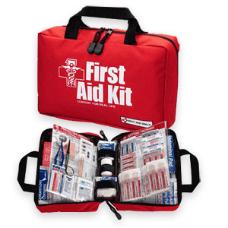
First Aid Kit
A First Aid Kit Can be a small pouch containing:
Bandages, Rolled Bandages, Gauze Pads, Adhesive Tape, Moleskin, Small Bar of Soap or Liquid Soap, Antibiotic Ointment, Small Pair of Scissors, Splints, Gloves (NON-Latex), Strike Anywhere Matches, and anything a scout will need if he has an allergic reaction.
The Troop also carries a First Aid Kit, but BRING YOUR OWN!!!

Slide 19
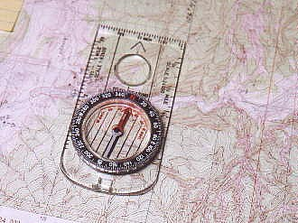
Map & Compass
Always have a Map of where you are staying, so you know the location of the place if you get lost. A Compass will help you find a direction if you get lost.

Slide 20
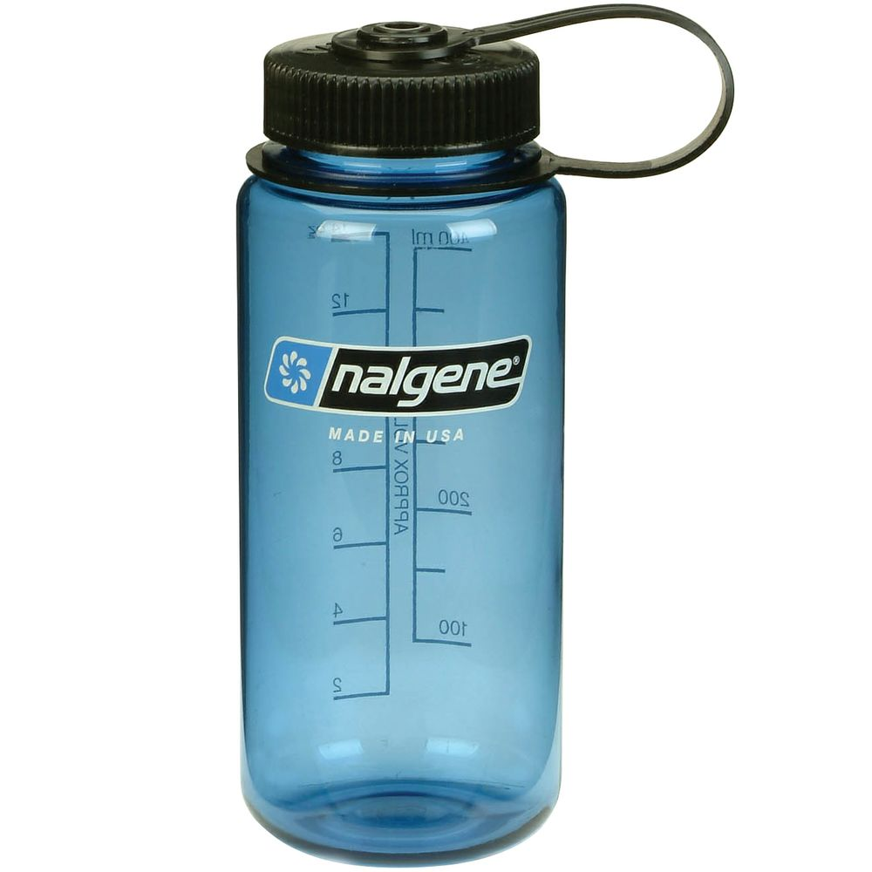

Water Bottle
Bring 1 for You, 1 for your Patrol, & 1 for the Troop.
On campouts where the Troop will NOT have access to water, bring EXTRA Water Bottles.
Be Prepared!

Slide 21
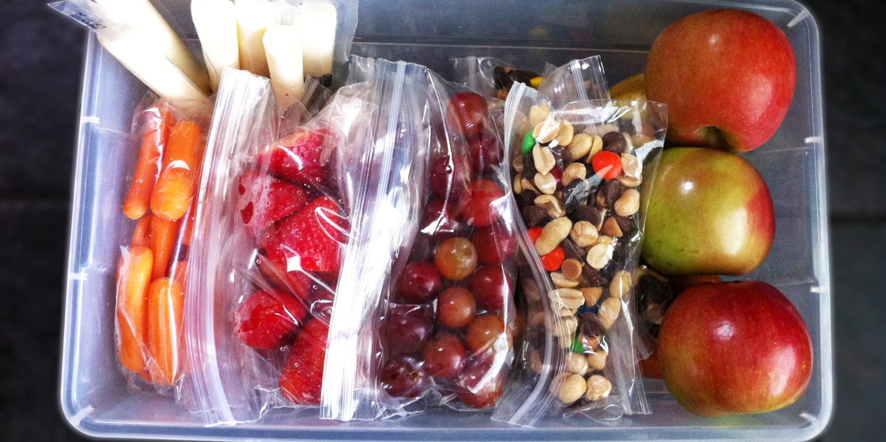
Extra Food
Pack a few Protein-Packed Granola Bars, Fruit, Cut-Up Vegetables, or Nuts to give you energy on a hike along the trail.

Slide 22
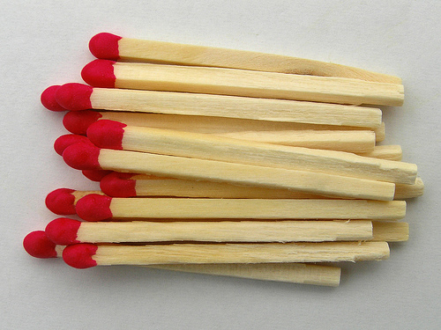
Matches/Fire Starters/Combustibles
Always have a pack of matches with you to start a fire.
You never know when you will need it!

Slide 23
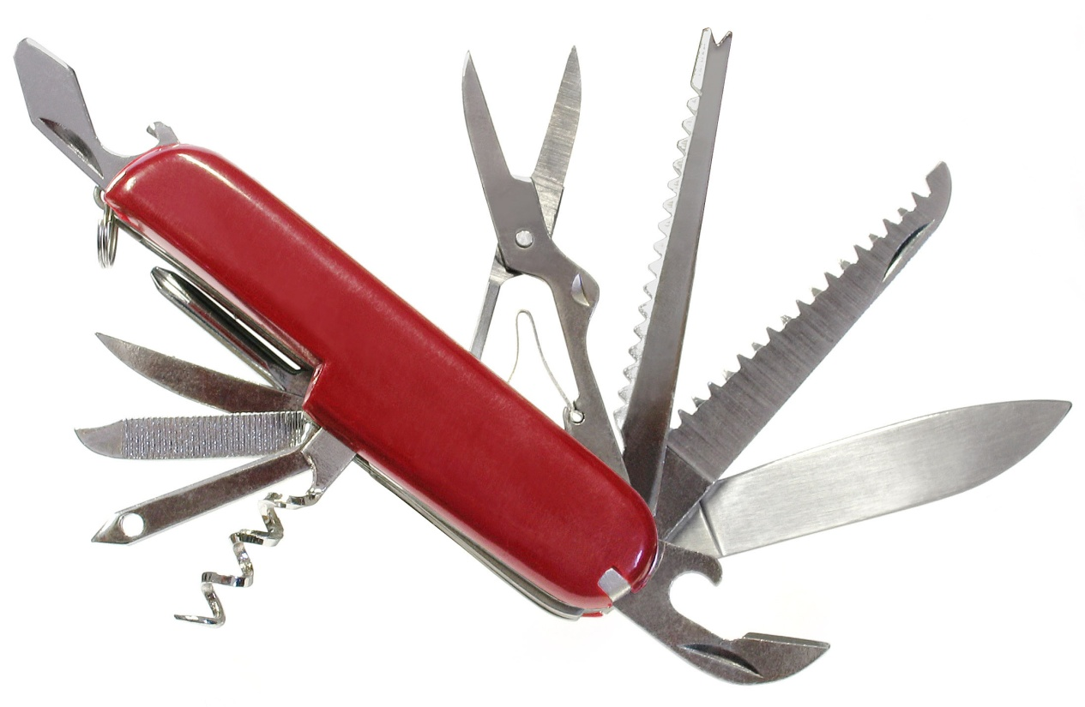
Pocket Knife
Always have a Pocket Knife on a campout to cut rope or other items.
Purchase a Swiss Army Knife or one at the Scout Shop.

Slide 24
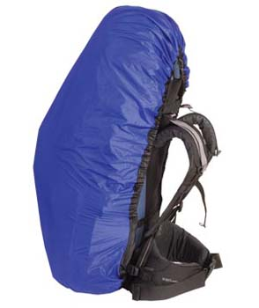
Pack Cover
Have a Pack Cover to keep your backpack dry and clean.
It can be as simple as a garbage bag or purchased with or separately with your backpack.

Slide 25
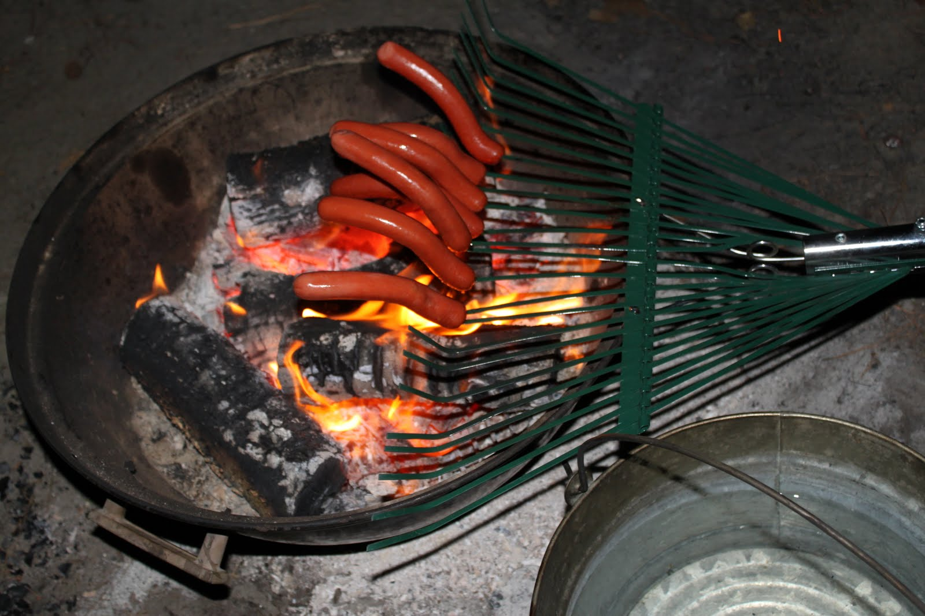
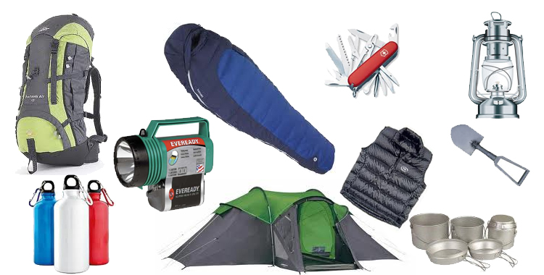
Troop/Patrol Food & Gear
Make sure to bring anything the Patrol Leader, Adult, or Senior Patrol Leaders assign you.
Usually, each scout will bring a food item and a piece of gear.

Slide 26
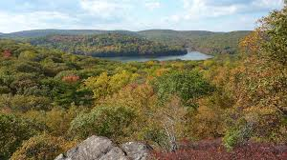
Extra Items
A scout may bring any other item he feels he will need on the campout.

Slide 27
Packing a Backpack
Backpack brought and packed by Josh Isaac

Slide 28
When packing a backpack…
Place sleeping bags in the bottom of the backpack if you have an Internal Frame Backpack.
Attach the sleeping bag to the outside of the pack if you have an External Frame Backpack.
Heavy items should be placed in the middle of the backpack. This will keep the carrier balanced on hilly trails.
Place lighter items in the top of the backpack for balance as well.
After packing, cover the top of your pack so the items don’t get dirty or wet.

Slide 29
Packing a Backpack
Strategies

Slide 30
Strategies for Packing a Backpack
Make sure anything that could harm or puncture the carrier is secured so it does not get loose.
Keep it compact! Not enough space in your backpack could be a problem. Keep everything as condensed and tight as possible. Tighten the straps to get rid of excess air.
Simple Strategy: Instead of one person carrying an entire tent, split the parts of the tent between the users.
Ex.: Camper A takes the rain tarp and poles, Camper B takes the ground tarp and bags, & Camper C take the tent.

Slide 31
Sizing a Backpack
Backpack brought and packed by Josh Isaac

Slide 32
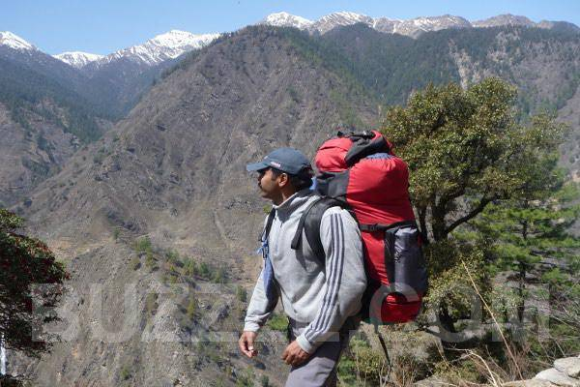
Weight Distribution
Adjust the straps of the backpack so approximately 80% of the weight of the backpack is on the carrier’s hips and approximately 20% is on the carrier’s shoulders.

Slide 33
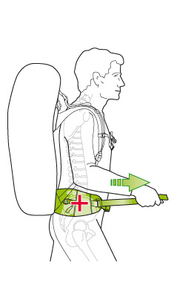
Hip Strap
Make the inner hip belt tight so it doesn’t slip down but not too tight that it is cutting off your circulation.

Slide 34
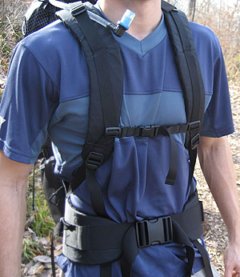
Shoulder Straps
Tighten the shoulder straps enough that they are not falling off, but not too tight that the weight is moving up to your shoulders.

Slide 35
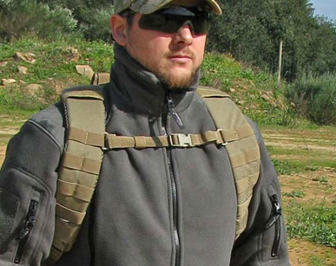
Chest Straps
Most backpacks offer chest straps.
Tighten it to keep the strap on your chest, but not too tight that you’re hurting yourself.
Sizes do vary on the chest straps and where they are placed on the backpack (in terms of height).

Slide 36
Adjustments
It is definitely fine to make minor adjustments, but don’t start pulling all the straps like crazy on the trail.
This WILL throw off your balance and your fellow scouts won’t appreciate having to constantly stop for you.
Size the backpack with all the gear BEFORE attending the campout.

Slide 37
Nighttime Clothing & Gear
A Sleeping Bag won’t be enough

Slide 38
Clothing at Night
Keep your Inner Layer on.
Wear a hat. You lose most of your heat through your head.
Change your clothes before sleeping.
Put extra clothing at the bottom of your sleeping bag. This will keep the clothes warmer than if they were in the backpack.

Slide 39
Gear at Night
Make sure to put down your Sleeping Pad to have a barrier between a warm sleeping bag and the freezing ground.
Keep the tent flap partially open. Otherwise, you will wake up to a tent full of water that might freeze. When you exhale, the vapor is made up of partially water. Without the tent flap open, the condensation has nowhere to go.
Put clothes in separate bags for the morning. Have them organized by layer.

Slide 40
And…
Go to the bathroom before going to sleep.
It is a living nightmare to get up in very cold weather to do your business.
Some people carry an empty water bottle with them so they don’t have to go outside if they have to go. If that happens, put the bottle outside your tent after you go.
You don’t want that spilling in your tent!!!

Slide 41
Helpful Hints

Slide 42
Clothing Hints
Change your socks OFTEN!
Keep your head covered.
COTTON KILLS!!!
Nobody cares if your shirt, pants, and shoes are not matching.
Pack light, but warm clothing.
The outermost layer must be a windbreaker [even after taking off layers].

Slide 43
Gear & Packing Hints
Decompress everything!
Adjust the straps before hiking.
Split up large pieces of gear.

Slide 44
Use the COLD Method

Slide 45
C is for Clean
Keep all the insulated layers you have fluffy and clean so no dirt accumulates and so the insulated layers replace the cold air with warm air.

Slide 46
O is for Overheating
If you are warm, TAKE OFF a layer (starting with the OUTERMOST Layer).
If you sweat, the sweat droplets will freeze, and then you will become hypothermic.

Slide 47
L is for Loose
Make sure all your layers fit and are NOT tight. You don’t want your circulation to get cut off.
Wear loose fitting, but warm clothes when camping in the Winter.

Slide 48
D is for Dry
Keep your layers dry by wearing waterproof items, or make sure your outermost layer is waterproof.
DON’T WEAR COTTON!!!

Slide 49
Questions?

